Slide 1

Support Vector Machines
Prof. Dr. Faisal Shafait
Professor
School of Electrical Engineering and Computer Science (SEECS)
National University of Sciences and Technology (NUST), Islamabad

Slide 2
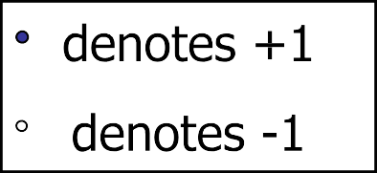
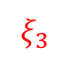
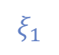
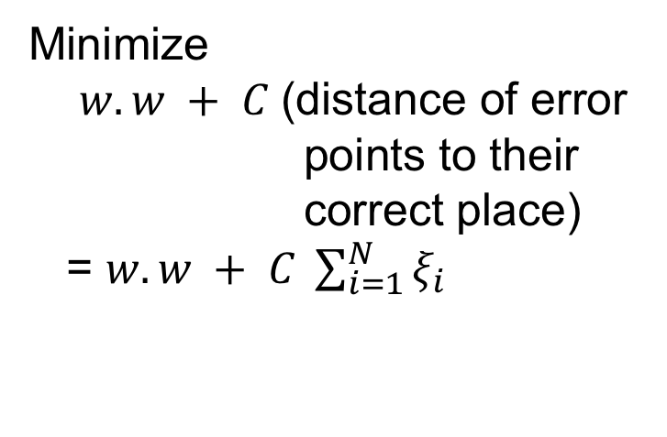
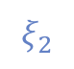
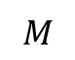
Hard Margin
Minimize
$w.w + C$(distance of error points to their correct place)
= $w.w + C \sum_{i=1}^{N}{ξ_{i}}$
$$ξ_{2}$$
$$ξ_{1}$$
$$M$$
When the value of C is large, more weight is given to training errors. Hence, the solution often has a narrow margin width
$$ξ_{3}$$

Slide 3
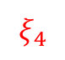
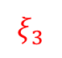
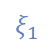
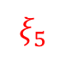
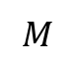
Soft Margin
Minimize
$w.w + C$(distance of error points to their correct place)
= $w.w + C \sum_{i=1}^{N}{ξ_{i}}$
$$ξ_{2}$$
$$ξ_{4}$$
$$ξ_{1}$$
$$M$$
$$ξ_{5}$$
$$ξ_{3}$$
When the value of C is small, more weight is given to increasing the margin width by tolerating a higher training error. This often yields to a better generalization on the test data

Slide 4
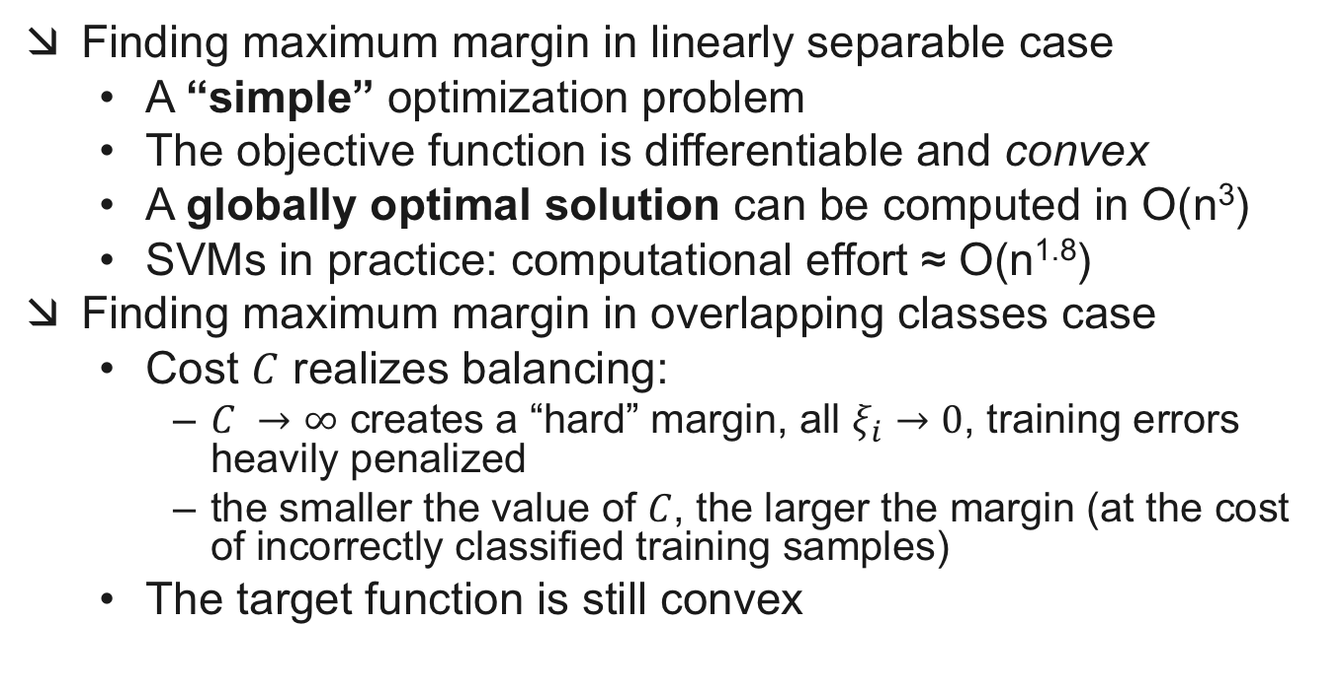
Margin Maximization Problem
Finding maximum margin in linearly separable case
A “simple” optimization problem
The objective function is differentiable and convex
A globally optimal solution can be computed in O(n³)
SVMs in practice: computational effort ≈ O(n^{1.8})
Finding maximum margin in overlapping classes case
Cost $C$ realizes balancing:
$C →∞$ creates a “hard” margin, all $ξ_{i}$ $→0$, training errors heavily penalized
the smaller the value of $C$, the larger the margin (at the cost of incorrectly classified training samples)
The target function is still convex

Slide 5
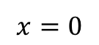
Suppose we’re in 1-dimension
What would SVMs do with this data?
$$x=0$$

Slide 6




Suppose we’re in 1-dimension
Not a big surprise.
$$x=0$$

Slide 7
Harder 1-dimensional dataset
That wiped the smirk off SVM’s face.
What can be done about this?
$$x=0$$

Slide 8

Kernel Trick

Slide 9
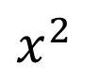
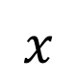
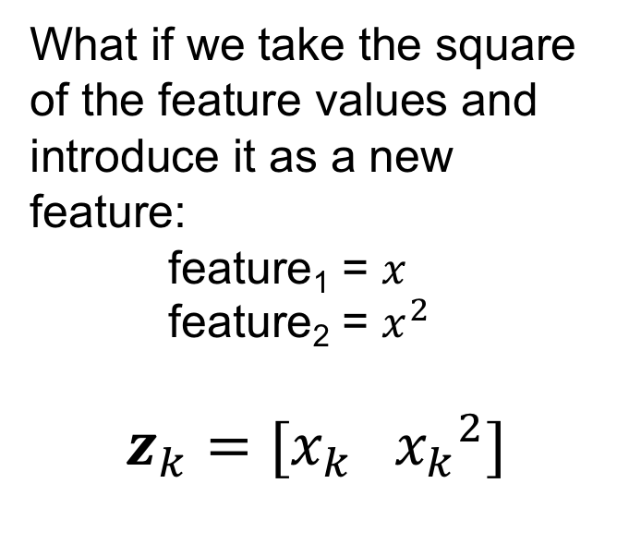
Harder 1-dimensional dataset
$x^{2}$
What if we take the square of the feature values and introduce it as a new feature:
feature₁ = $x$
feature₂ = $x^{2}$
$$z_{k}=[x_{k} {x_{k}}^{2}]$$
$$x$$

Slide 10
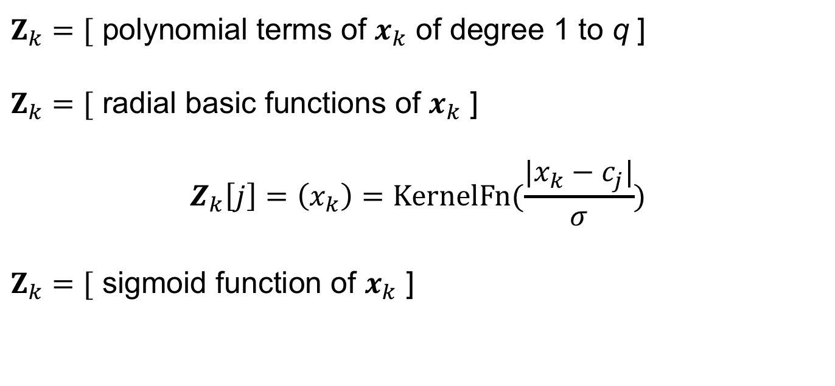
Transformation Functions
$Z_{k}=[$ polynomial terms of $x_{k}$ of degree 1 to q ]
$Z_{k}=[$ radial basic functions of $x_{k}$ ]
$$Z_{k}\left[j\right]=\left(x_{k}\right)=\text{KernelFn}(\frac{|x_{k}−c_{j}|}{σ})$$
$Z_{k}=[$ sigmoid function of $x_{k}$ ]

Slide 11
Kernel Trick
Data separability increases in higher dimensions
Transform your data to a higher dimension to increase separability
In practice, finding “good” data transformations for your classification problem can be difficult.
This approach leads to the idea of the kernel trick

Slide 12
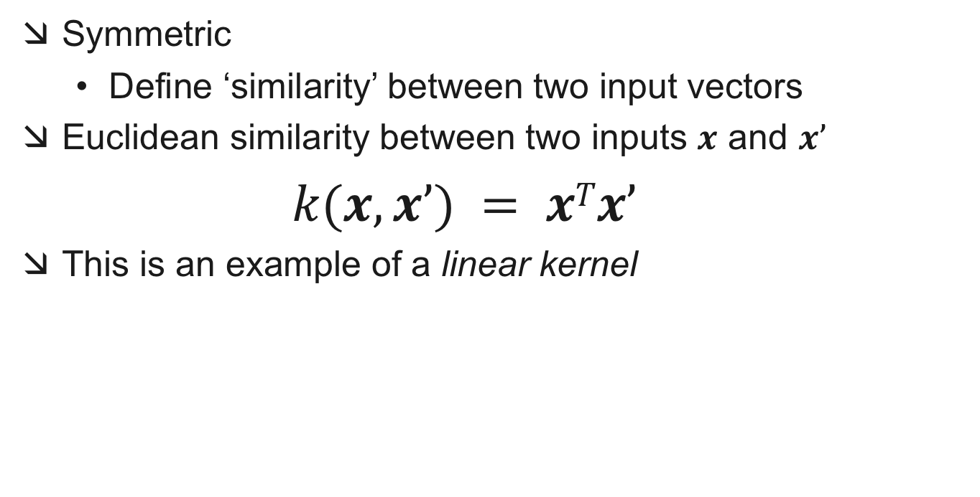
Kernel Functions
Symmetric
Define ‘similarity’ between two input vectors
Euclidean similarity between two inputs $x$ and $x’$
$k(x,x’) = xTx’$
This is an example of a linear kernel

Slide 13
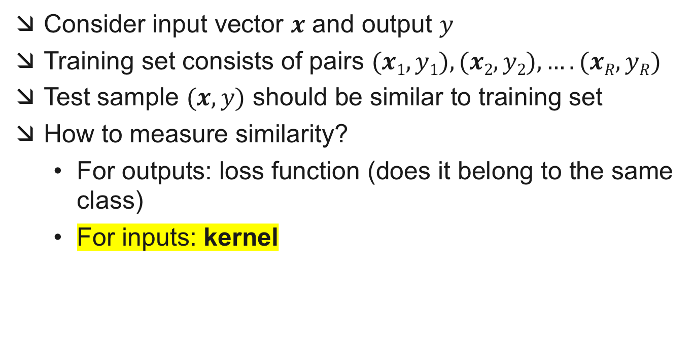
Kernel Methods
Consider input vector $x$ and output $y$
Training set consists of pairs $(x1,y1), (x2,y2), …. (xR,yR)$
Test sample $(x,y)$ should be similar to training set
How to measure similarity?
For outputs: loss function (does it belong to the same class)
For inputs: kernel

Slide 14
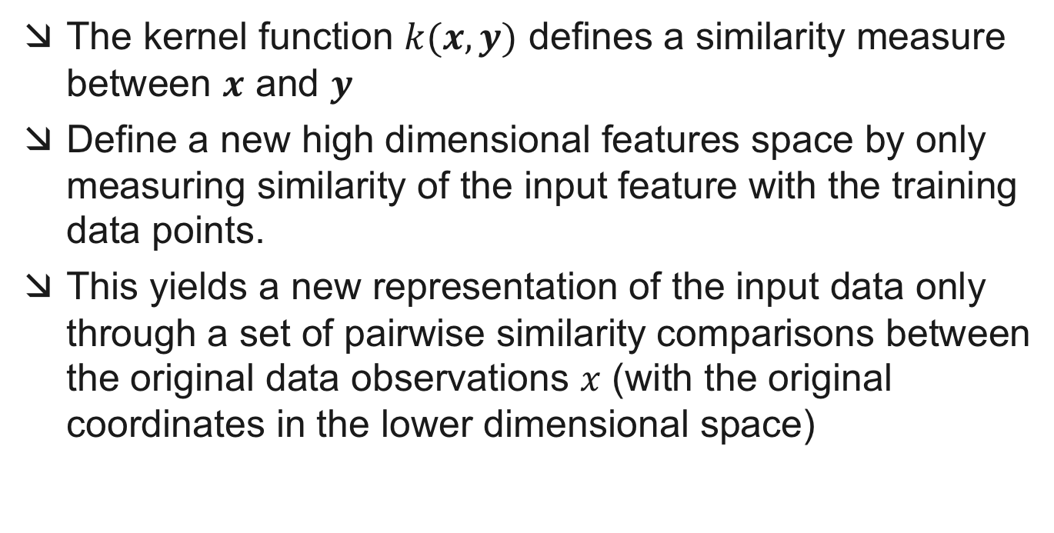
Kernel Trick
The kernel function $k(x,y)$ defines a similarity measure between $x$ and $y$
Define a new high dimensional features space by only measuring similarity of the input feature with the training data points.
This yields a new representation of the input data only through a set of pairwise similarity comparisons between the original data observations $x$ (with the original coordinates in the lower dimensional space)

Slide 15
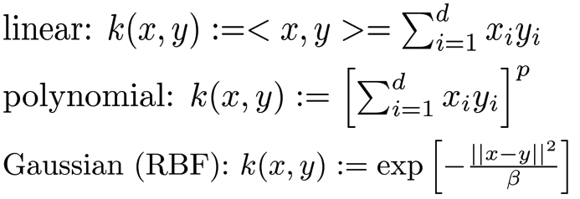
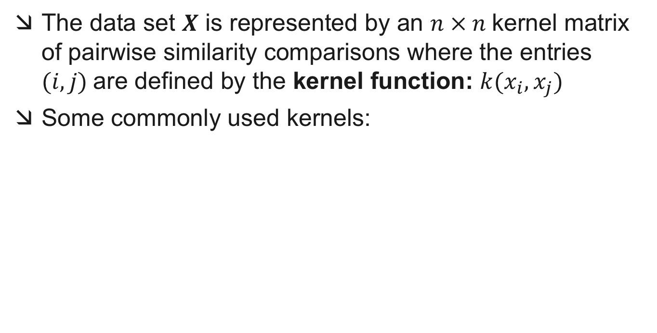
Kernel Trick
The data set $X$ is represented by an $n × n$kernel matrix of pairwise similarity comparisons where the entries $(i, j)$are defined by the kernel function: $k(x_{i}, x_{j})$
Some commonly used kernels:

Slide 16
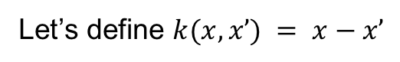
Kernel Trick
Let’s consider a one-dimensional dataset with $n=9$samples; $x$ represents the
feature values and $y$ represents the class label {-1, 1}
$$y$$ | $$−1$$ | $$−1$$ | $$−1$$ | $$1$$ | $$1$$ | $$1$$ | $$1$$ | $$−1$$ | $$−1$$
$$x$$ | $$−3$$ | $$−2$$ | $$−1$$ | $$0$$ | $$1$$ | $$2$$ | $$3$$ | $$4$$ | $$5$$
Let’s define $k(x,x’) = x−x’$

Slide 17
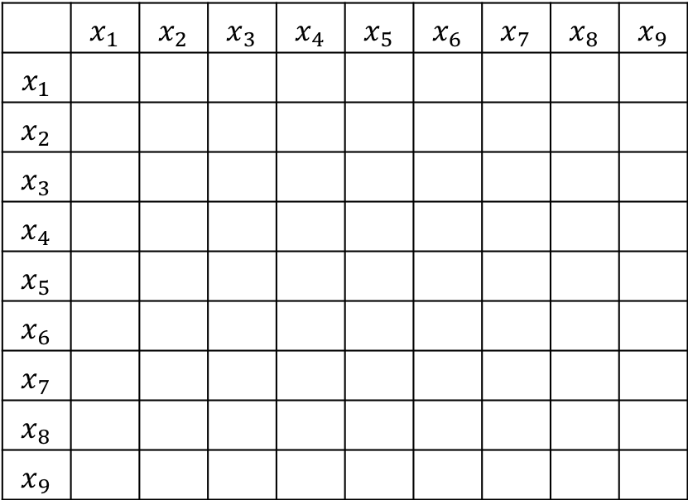
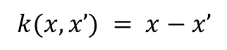
Kernel Trick
$$y$$ | $$−1$$ | $$−1$$ | $$−1$$ | $$1$$ | $$1$$ | $$1$$ | $$1$$ | $$−1$$ | $$−1$$
$$x$$ | $$−3$$ | $$−2$$ | $$−1$$ | $$0$$ | $$1$$ | $$2$$ | $$3$$ | $$4$$ | $$5$$
 | $$x_{1}$$ | $$x_{2}$$ | $$x_{3}$$ | $$x_{4}$$ | $$x_{5}$$ | $$x_{6}$$ | $$x_{7}$$ | $$x_{8}$$ | $$x_{9}$$
$$x_{1}$$
$$x_{2}$$
$$x_{3}$$
$$x_{4}$$
$$x_{5}$$
$$x_{6}$$
$$x_{7}$$
$$x_{8}$$
$$x_{9}$$
$$k(x,x’) = x−x’$$

Slide 18
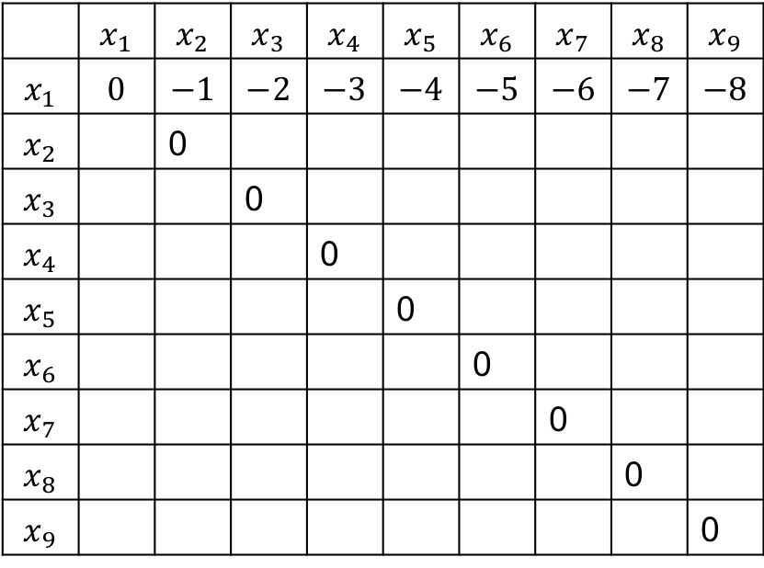
Kernel Trick
$$y$$ | $$−1$$ | $$−1$$ | $$−1$$ | $$1$$ | $$1$$ | $$1$$ | $$1$$ | $$−1$$ | $$−1$$
$$x$$ | $$−3$$ | $$−2$$ | $$−1$$ | $$0$$ | $$1$$ | $$2$$ | $$3$$ | $$4$$ | $$5$$
 | $$x_{1}$$ | $$x_{2}$$ | $$x_{3}$$ | $$x_{4}$$ | $$x_{5}$$ | $$x_{6}$$ | $$x_{7}$$ | $$x_{8}$$ | $$x_{9}$$
$$x_{1}$$ | $$0$$ | $$−1$$ | $$−2$$ | $$−3$$ | $$−4$$ | $$−5$$ | $$−6$$ | $$−7$$ | $$−8$$
$$x_{2}$$ |  | 0
$$x_{3}$$ |  |  | 0
$$x_{4}$$ |  |  |  | 0
$$x_{5}$$ |  |  |  |  | 0
$$x_{6}$$ |  |  |  |  |  | 0
$$x_{7}$$ |  |  |  |  |  |  | 0
$$x_{8}$$ |  |  |  |  |  |  |  | 0
$$x_{9}$$ |  |  |  |  |  |  |  |  | 0
$$k(x,x’) = x−x’$$

Slide 19
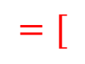
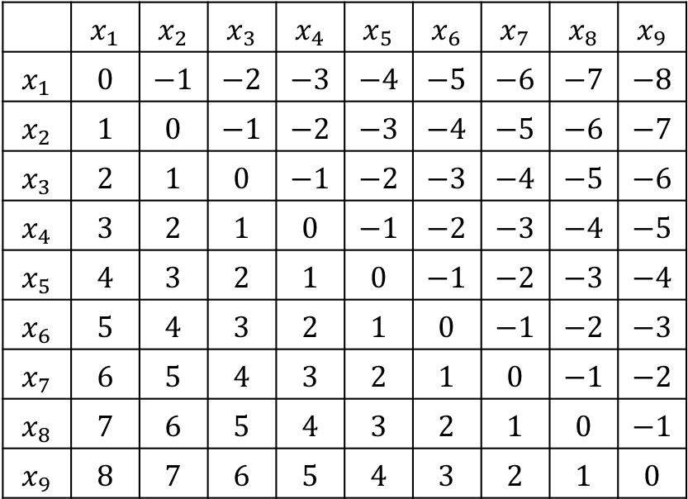
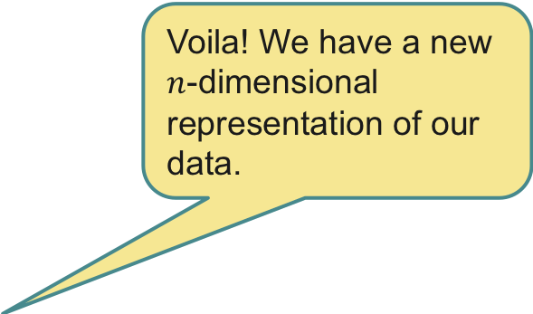

Kernel Trick
$$y$$ | $$−1$$ | $$−1$$ | $$−1$$ | $$1$$ | $$1$$ | $$1$$ | $$1$$ | $$−1$$ | $$−1$$
$$x$$ | $$−3$$ | $$−2$$ | $$−1$$ | $$0$$ | $$1$$ | $$2$$ | $$3$$ | $$4$$ | $$5$$
 | $$x_{1}$$ | $$x_{2}$$ | $$x_{3}$$ | $$x_{4}$$ | $$x_{5}$$ | $$x_{6}$$ | $$x_{7}$$ | $$x_{8}$$ | $$x_{9}$$
$$x_{1}$$ | $$0$$ | $$−1$$ | $$−2$$ | $$−3$$ | $$−4$$ | $$−5$$ | $$−6$$ | $$−7$$ | $$−8$$
$$x_{2}$$ | $$1$$ | $$0$$ | $$−1$$ | $$−2$$ | $$−3$$ | $$−4$$ | $$−5$$ | $$−6$$ | $$−7$$
$$x_{3}$$ | $$2$$ | $$1$$ | $$0$$ | $$−1$$ | $$−2$$ | $$−3$$ | $$−4$$ | $$−5$$ | $$−6$$
$$x_{4}$$ | $$3$$ | $$2$$ | $$1$$ | $$0$$ | $$−1$$ | $$−2$$ | $$−3$$ | $$−4$$ | $$−5$$
$$x_{5}$$ | $$4$$ | $$3$$ | $$2$$ | $$1$$ | $$0$$ | $$−1$$ | $$−2$$ | $$−3$$ | $$−4$$
$$x_{6}$$ | $$5$$ | $$4$$ | $$3$$ | $$2$$ | $$1$$ | $$0$$ | $$−1$$ | $$−2$$ | $$−3$$
$$x_{7}$$ | $$6$$ | $$5$$ | $$4$$ | $$3$$ | $$2$$ | $$1$$ | $$0$$ | $$−1$$ | $$−2$$
$$x_{8}$$ | $$7$$ | $$6$$ | $$5$$ | $$4$$ | $$3$$ | $$2$$ | $$1$$ | $$0$$ | $$−1$$
$$x_{9}$$ | $$8$$ | $$7$$ | $$6$$ | $$5$$ | $$4$$ | $$3$$ | $$2$$ | $$1$$ | $$0$$
Voila! We have a new $n$-dimensional representation of our data.
$$=[$$
$$]$$
$$k(x,x’) = x−x’$$

Slide 20
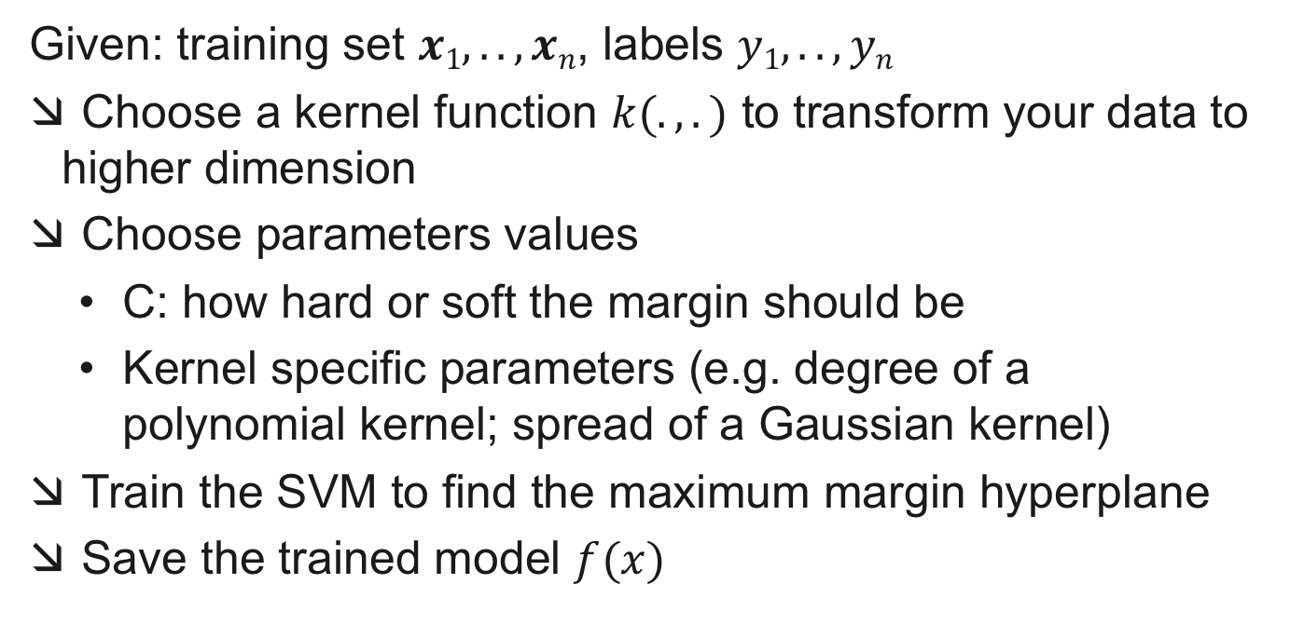
SVM Training
Given: training set $x1,..,xn$, labels $y1, .., yn$
Choose a kernel function $k(.,.)$ to transform your data to higher dimension
Choose parameters values
C: how hard or soft the margin should be
Kernel specific parameters (e.g. degree of a polynomial kernel; spread of a Gaussian kernel)
Train the SVM to find the maximum margin hyperplane
Save the trained model $f(x)$

Slide 21
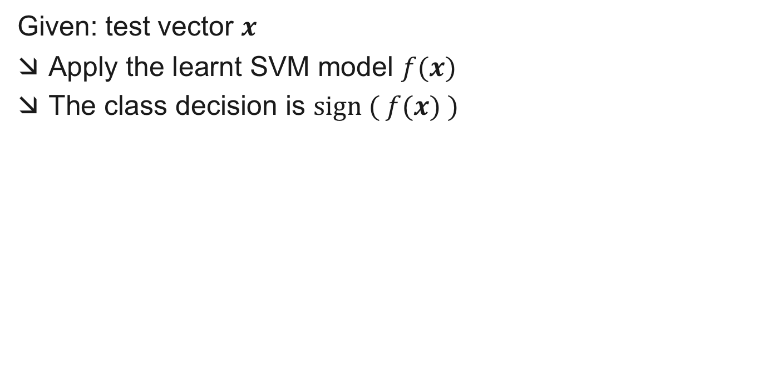
SVM Classification
Given: test vector $x$
Apply the learnt SVM model $f(x)$
The class decision is $\text{sign} ( f(x) )$

